Slide 1

Best neighborhood in Nyc for a Indian cuisine
Clement emerson a
clementemerson@gmail.com

Slide 2
Problem statement
Where would an Indian hotelier open an Indian style restaurant in New York, USA?

Slide 3
DATA
List of neighbourhoods in NYC
List of restaurants in each neighbourhood within 2KM
Category of the restaurant

Slide 4
Methodology
kMeans clustering algorithm
4 different cluster configurations
Considers different types of Indian cuisines

Slide 5
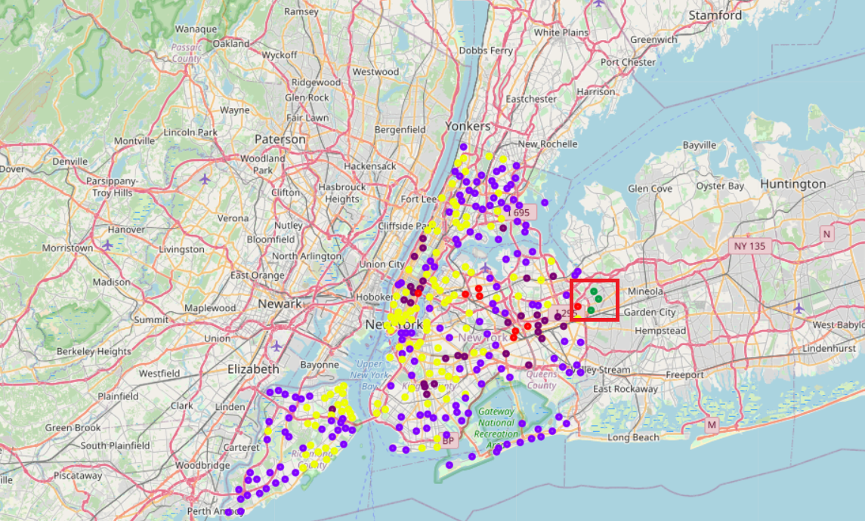
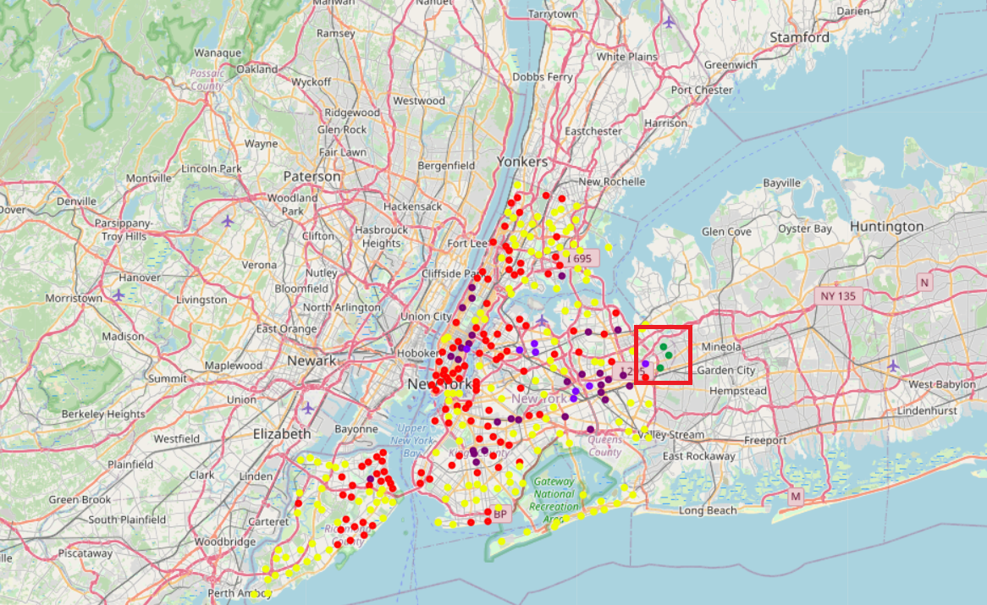
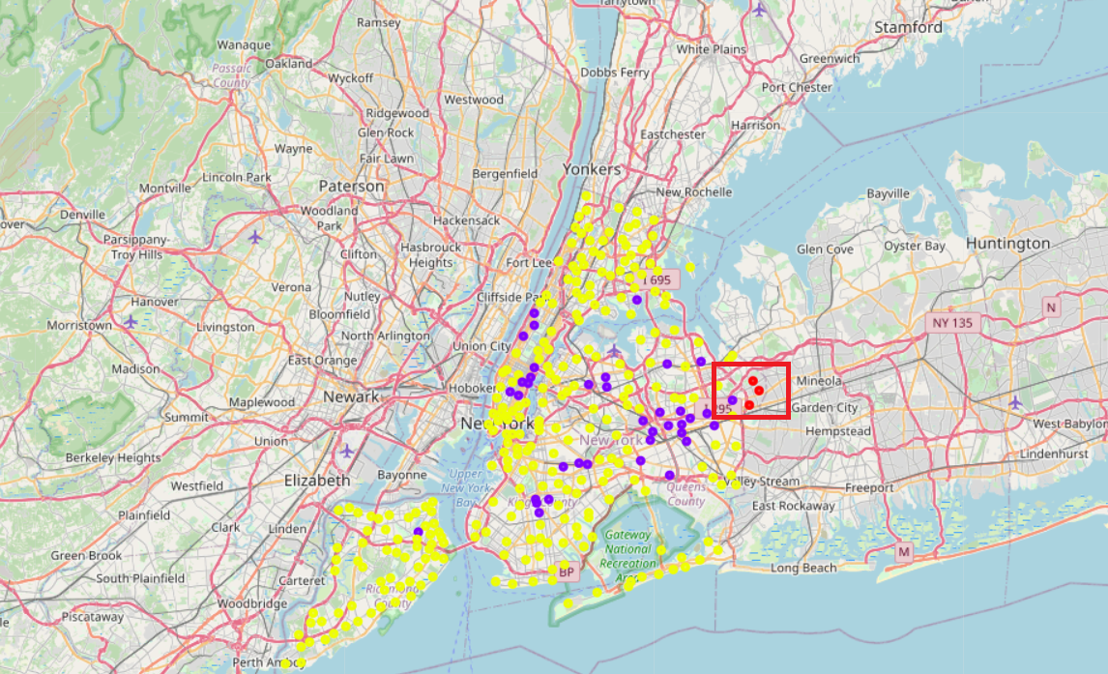
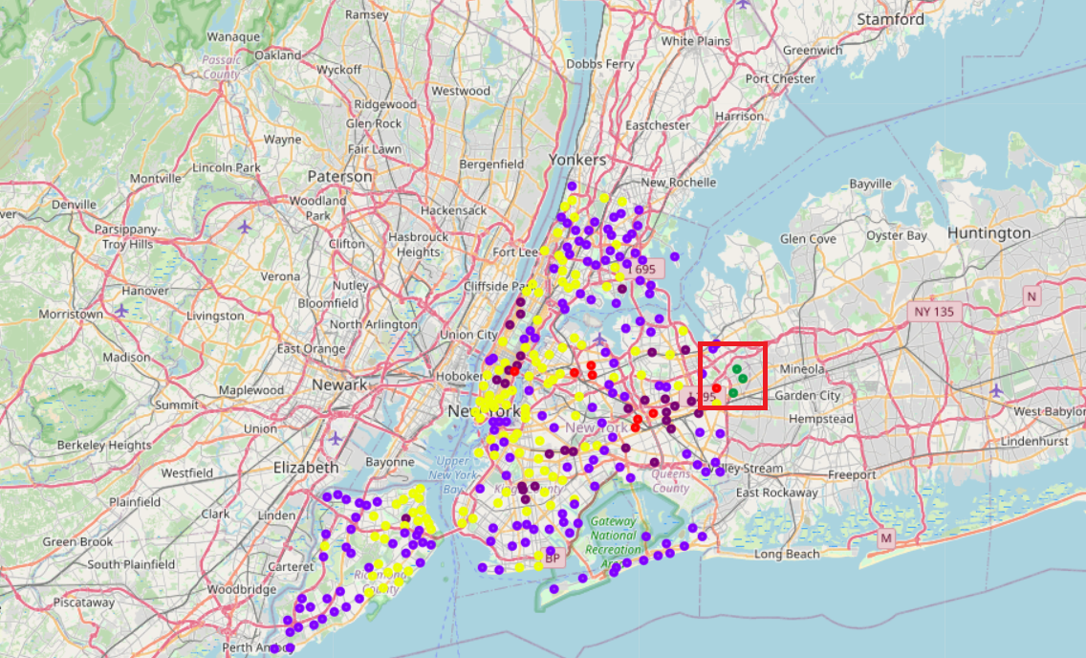
Result

Slide 6
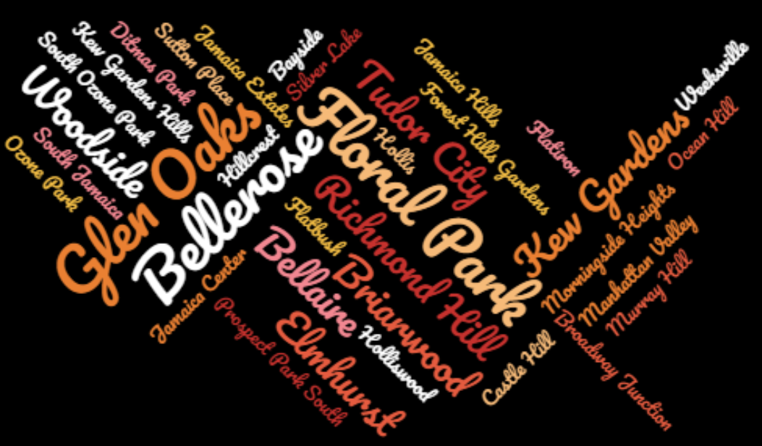
Conclusion

